Slide 1
Chapter 15
The Early Renaissance in Fifteenth-Century Italy

Slide 2
Learning Objectives
Define the characteristics of Italian Renaissance style.
Summarize the intellectual and social factors that inform Renaissance art.
Discuss the spread of artistic ideas into and out of Florence.
Describe the settings for which works of art were made in the Italian Renaissance.
Recognize the most important artists and patrons of the fifteenth century.

Slide 3
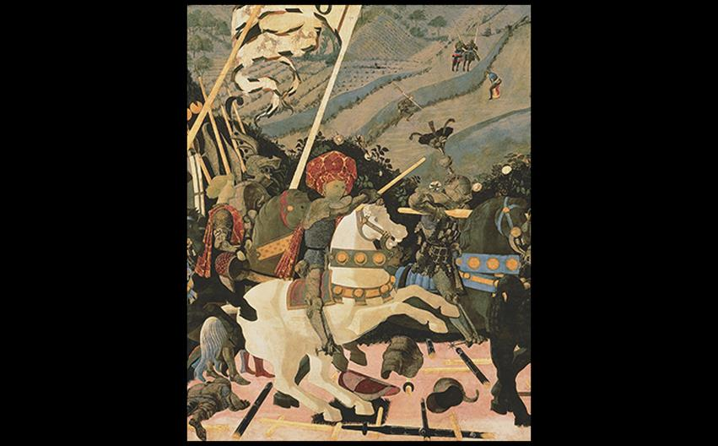
Paolo Uccello NICCOLÒ DA TOLENTINO LEADING THE CHARGE Detail from The Battle of San Romano (FIG. 20-24), 1438–1440. Tempera on wood panel. National Gallery, London. © 2016. Copyright The National Gallery, London/Scala, Florence.
Notes:
Paolo Uccello NICCOLÒ DA TOLENTINO LEADING THE CHARGE Detail from The Battle of San Romano (FIG. 20-24), 1438–1440. Tempera on wood panel. National Gallery, London. © 2016. Copyright The National Gallery, London/Scala, Florence.

Slide 4
Humanism and the Italian Renaissance (1 of 2)
Cities grew in wealth as people migrated from the countryside, and commerce became increasingly vital.
Italian humanists looked back to art and determined that achievements of the Classical world were followed by a perceived decline.
They sought to revive physical and literary records of the ancient world.

Slide 5
Humanism and the Italian Renaissance (2 of 2)
Artists turned to antiquity for inspiration and emulated what they saw in ancient Roman sculpture and architecture.
Italian painters and sculptors increasingly rendered the illusion of physical reality in a more analytical way than that of northerners.

Slide 6
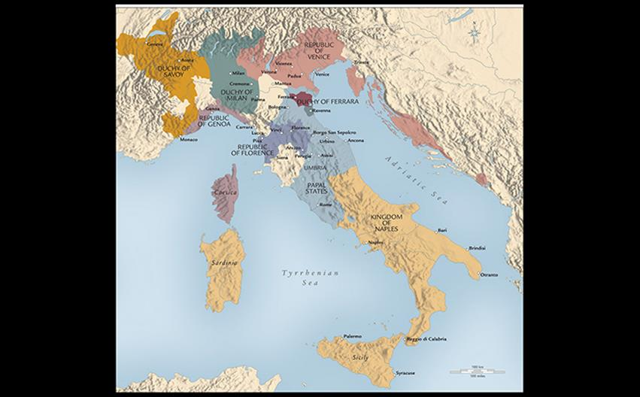
FIFTEENTH-CENTURY ITALY Powerful families divided the Italian peninsula into city-states: the Medici in Florence, the Visconti and Sforza in Milan, the Montefeltro in Urbino, the Gonzaga in Mantua, and the Este in Ferrara. After 1420, the popes ruled Rome, while in the south Naples and Sicily were French and then Spanish (Aragonese) territories. Venice maintained its independence as a republic.
Notes:
FIFTEENTH-CENTURY ITALY Powerful families divided the Italian peninsula into city-states: the Medici in Florence, the Visconti and Sforza in Milan, the Montefeltro in Urbino, the Gonzaga in Mantua, and the Este in Ferrara. After 1420, the popes ruled Rome, while in the south Naples and Sicily were French and then Spanish (Aragonese) territories. Venice maintained its independence as a republic.

Slide 7
The Early Renaissance in Florence
The fifteenth century witnessed the rise of the Medici family, who made their money through banking.
The competitive atmosphere fostered both mercantile and artistic success.
Florence was considered a republic.
Artists could look to the Church, state (government and guilds), and individuals for patronage.

Slide 8
The Competition Reliefs (1 of 2)
Florence Cathedral sponsored a competition for the artist of the bronze doors and chose the scene of Abraham's sacrifice of Isaac.
Surviving panels belong to assumed finalists Lorenzo Ghiberti and Brunelleschi.

Slide 9
The Competition Reliefs (2 of 2)
Brunelleschi's composition is rugged, explosive, and intense.
Ghiberti's version is graceful with controlled poses and harmonious pairing of son and father.
His work proved to be lighter and less expensive when he was declared winner.
Brunelleschi withdrew his entry.

Slide 10
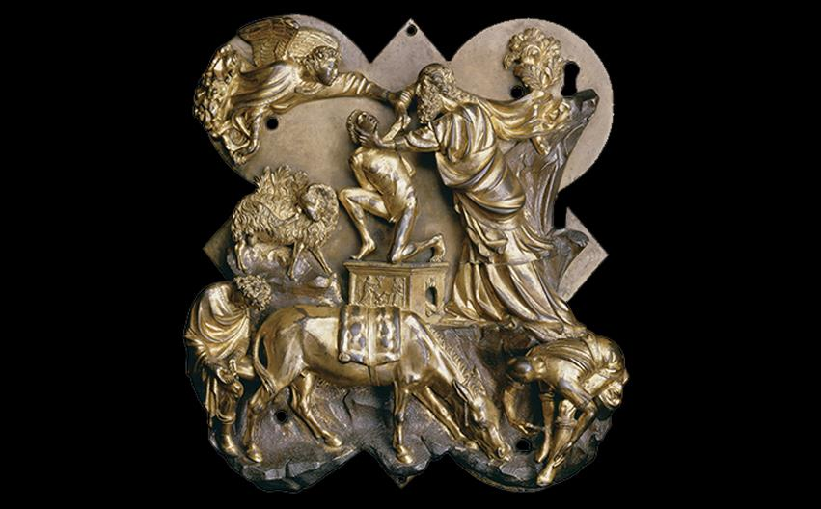
Filippo Brunelleschi SACRIFICE OF ISAAC 1401–1402. Bronze with gilding, 21 × 17-1/2" (53 × 44 cm) inside molding. Museo Nazionale del Bargello, Florence. © Studio Fotografico Quattrone, Florence
Notes:
Filippo Brunelleschi SACRIFICE OF ISAAC 1401–1402. Bronze with gilding, 21 × 17-1/2" (53 × 44 cm) inside molding. Museo Nazionale del Bargello, Florence. © Studio Fotografico Quattrone, Florence.

Slide 11
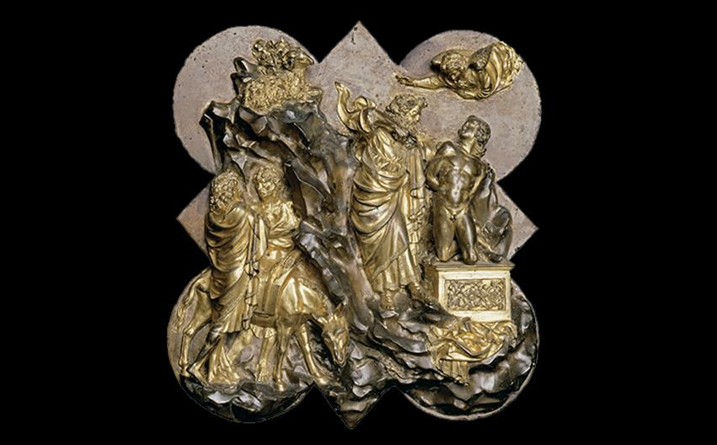
Lorenzo Ghiberti SACRIFICE OF ISAAC 1401–1402. Bronze with gilding, 21 × 17-1/2" (53 × 44 cm) inside molding. Museo Nazionale del Bargello, Florence. © Studio Fotografico Quattrone, Florence.
Notes:
Lorenzo Ghiberti SACRIFICE OF ISAAC 1401–1402. Bronze with gilding, 21 × 17-1/2" (53 × 44 cm) inside molding. Museo Nazionale del Bargello, Florence. © Studio Fotografico Quattrone, Florence.

Slide 12
Filippo Brunelleschi, Architect (1 of 6)
The defining civic project in Florence was the cathedral.
Construction began in the late thirteenth century, but architects did not yet have technology to complete the designed dome.
Brunelleschi was a principal pioneer of Florentine architecture.

Slide 13
Filippo Brunelleschi, Architect (2 of 6)
Florence Cathedral
The Dome of Florence Cathedral was a feat of engineering, with an octagonal outer shell and lower inner shell.
Each portion reinforced the next one as it was built layer by layer with no external support.

Slide 14
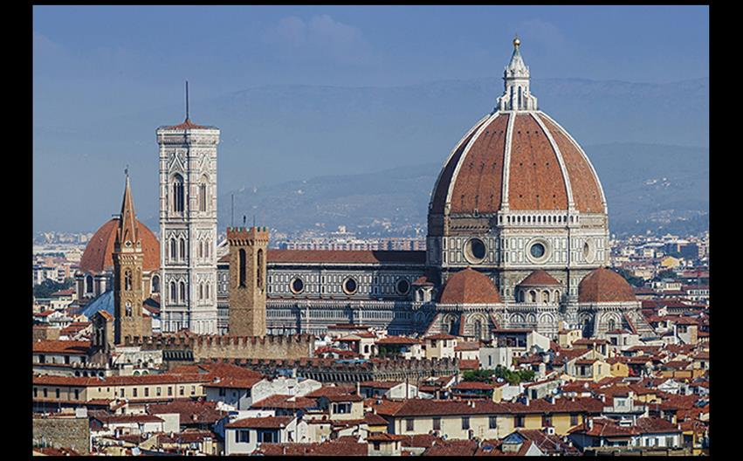
Filippo Brunelleschi DOME OF FLORENCE CATHEDRAL (SANTA MARIA DEL FIORE) 1420–1436; lantern completed 1471. © Javier Martin/123RF.
Notes:
Filippo Brunelleschi DOME OF FLORENCE CATHEDRAL (SANTA MARIA DEL FIORE) 1420–1436; lantern completed 1471. © Javier Martin/123RF.

Slide 15
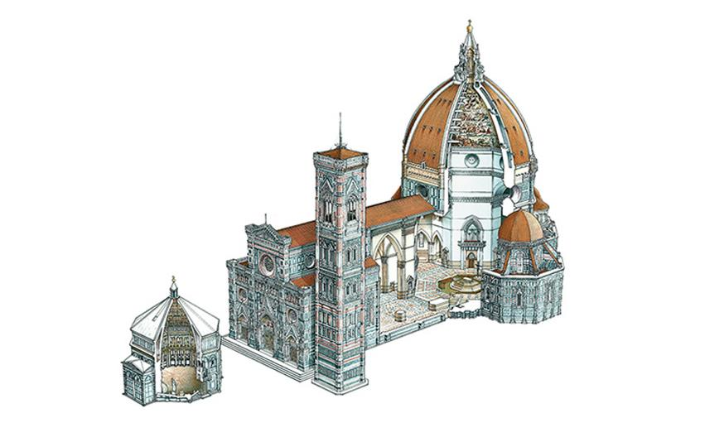
SCHEMATIC DRAWING OF FLORENCE CATHEDRAL The separate, central-plan building in front of the façade is the baptistery. Adjacent to the façade is a tall tower designed by Giotto in 1334. © Dorling Kindersley.
Notes:
SCHEMATIC DRAWING OF FLORENCE CATHEDRAL The separate, central-plan building in front of the façade is the baptistery. Adjacent to the façade is a tall tower designed by Giotto in 1334. © Dorling Kindersley.

Slide 16
Filippo Brunelleschi, Architect (3 of 6)
The Foundling Hospital
The Ospedale degli Innocenti was unprecedented in scale and design.
Brunelleschi paid homage to traditional forms and introduced features key to the Italian Renaissance style.
A later addition in 1487 included spandrels with terra-cotta medallions.

Slide 17
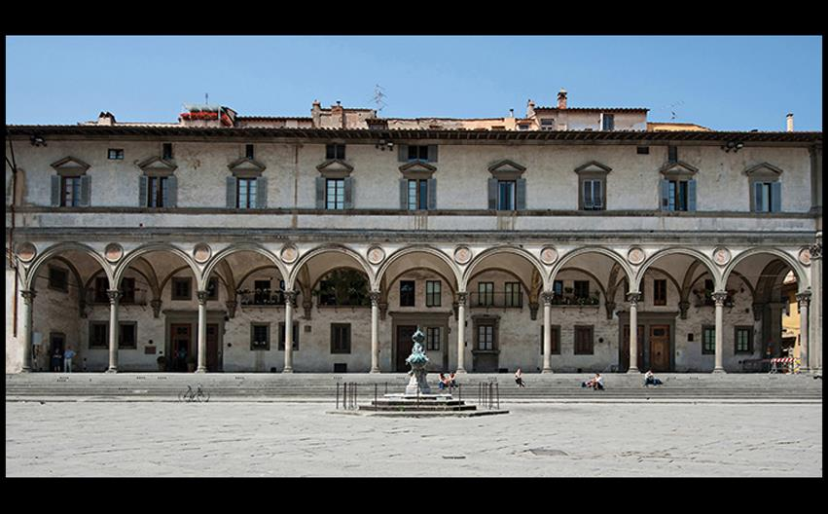
Filippo Brunelleschi OSPEDALE DEGLI INNOCENTI (FOUNDLING HOSPITAL), FLORENCE Designed 1419; begun under Brunelleschi's direct supervision 1421–1427; construction continued into the 1440s. Deposit Photos/Glow Images.
Notes:
Filippo Brunelleschi OSPEDALE DEGLI INNOCENTI (FOUNDLING HOSPITAL), FLORENCE Designed 1419; begun under Brunelleschi's direct supervision 1421–1427; construction continued into the 1440s. Deposit Photos/Glow Images.

Slide 18
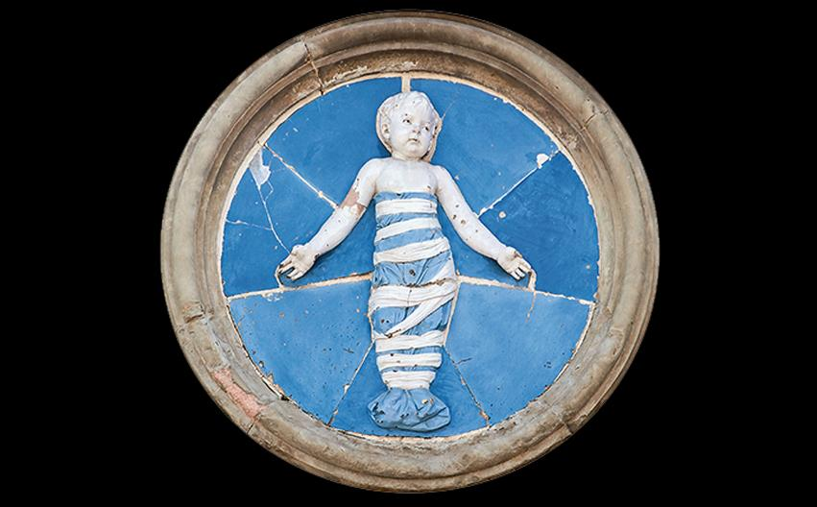
Andrea della Robbia INFANT IN SWADDLING CLOTHES (ONE OF THE HOLY INNOCENTS MASSACRED BY HEROD) Ospedale degli Innocenti (Foundling Hospital), Florence. 1487. Glazed terra cotta. pio3/Fotolia.
Notes:
Andrea della Robbia INFANT IN SWADDLING CLOTHES (ONE OF THE HOLY INNOCENTS MASSACRED BY HEROD) Ospedale degli Innocenti (Foundling Hospital), Florence. 1487. Glazed terra cotta. pio3/Fotolia.

Slide 19
Filippo Brunelleschi, Architect (4 of 6)
San Lorenzo
Brunelleschi also reconstructed the Church of San Lorenzo.
Clear, rational interior spaces are in harmony with one another.
The austere Roman-style basilica with a long nave has arches that spring from an impost block.

Slide 20
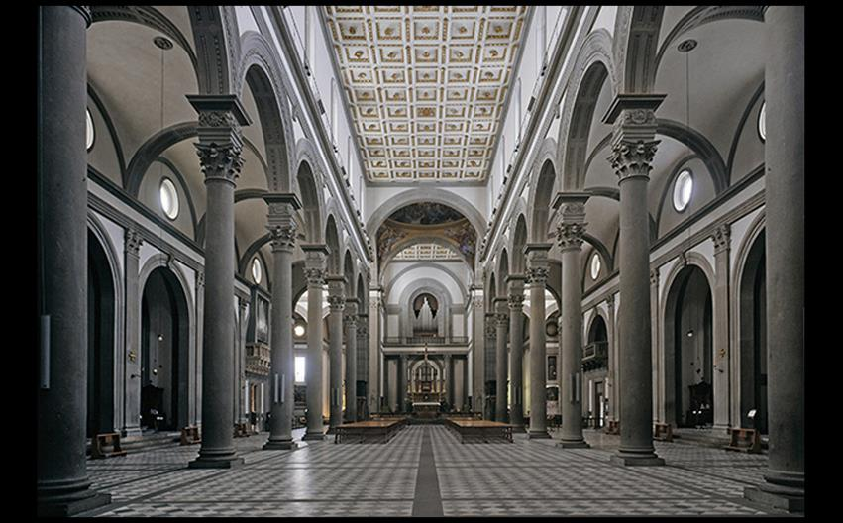
Filippo Brunelleschi (continued by Michelozzo di Bartolomeo) INTERIOR OF CHURCH OF SAN LORENZO, FLORENCE c. 1421–1428; nave (designed 1434?) 1442–1470. © Studio Fotografico Quattrone, Florence.
Notes:
Filippo Brunelleschi (continued by Michelozzo di Bartolomeo) INTERIOR OF CHURCH OF SAN LORENZO, FLORENCE c. 1421–1428; nave (designed 1434?) 1442–1470. © Studio Fotografico Quattrone, Florence.

Slide 21
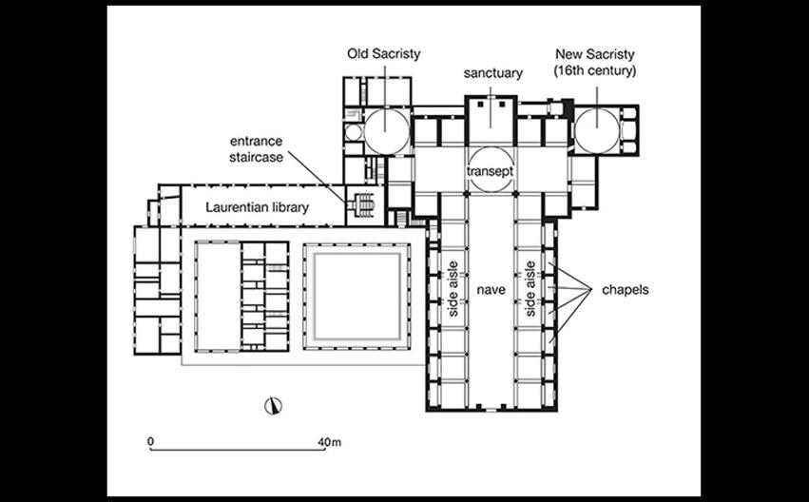
Filippo Brunelleschi (continued by Michelozzo di Bartolomeo) PLAN OF CHURCH OF SAN LORENZO, FLORENCE c. 1421–1428; nave (designed 1434?) 1442–1470.
Notes:
Filippo Brunelleschi (continued by Michelozzo di Bartolomeo) PLAN OF CHURCH OF SAN LORENZO, FLORENCE c. 1421–1428; nave (designed 1434?) 1442–1470.

Slide 22
Filippo Brunelleschi, Architect (5 of 6)
The Medici Palace
Brunelleschi had a role in the Palazzo Medici-Riccardi, although it was said that his model was rejected as too grand.
It is attributed to Michelozzo di Bartolomeo.
Rusticated stone blocks set the lower story apart from the upper levels.

Slide 23
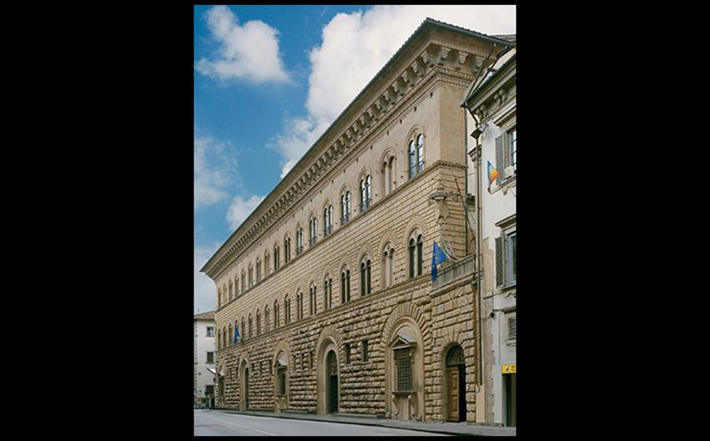
Attributed to Michelozzo di Bartolomeo FAÇADE, PALAZZO MEDICI-RICCARDI, FLORENCE Begun 1446 (the view shown here includes a two-bay extension constructed during the 18th century). © Achim Bednorz, Cologne.
Notes:
Attributed to Michelozzo di Bartolomeo FAÇADE, PALAZZO MEDICI-RICCARDI, FLORENCE Begun 1446 (the view shown here includes a two-bay extension constructed during the 18th century). © Achim Bednorz, Cologne.

Slide 24
Filippo Brunelleschi, Architect (6 of 6)
The Medici Palace
Inside the Palazzo, the Medici palace courtyard is square, with rooms arranged symmetrically.
The frieze is decorated with swags in sgraffito, which is produced by scratching through a layer of dark plaster or glaze.

Slide 25
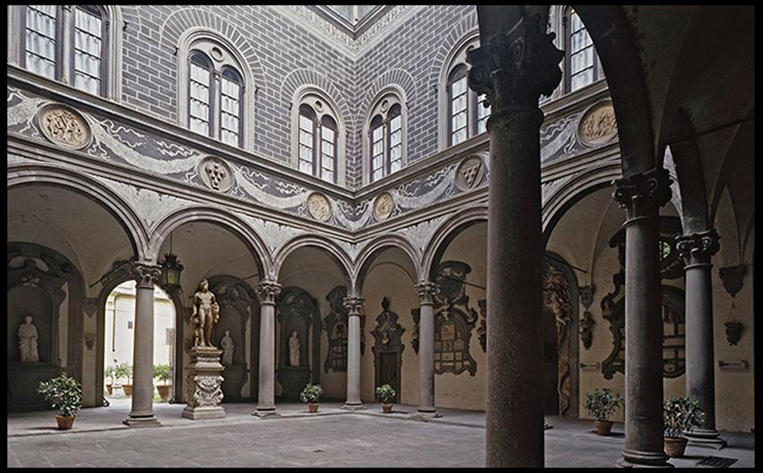
COURTYARD WITH SGRAFFITO DECORATION, PALAZZO MEDICI-RICCARDI, FLORENCE Begun 1446.
Notes:
COURTYARD WITH SGRAFFITO DECORATION, PALAZZO MEDICI-RICCARDI, FLORENCE Begun 1446.

Slide 26
Sculpture (1 of 6)
Until 1428, Florence's independence were challenged by the anti-republican powers, the duchy of Milan and the kingdom of Naples.
Florentines turned to commissions that expressed self-esteem and their city's magnificence.

Slide 27
Sculpture (2 of 6)
Orsanmichele
A loggia that served as a grain market was erected with sculpted images of patron saints.
Nanni di Banco produced The Four Crowned Martyrs with reference to Roman sculpture.
The saints convey a new spatial relationship to the building and the viewer.

Slide 28
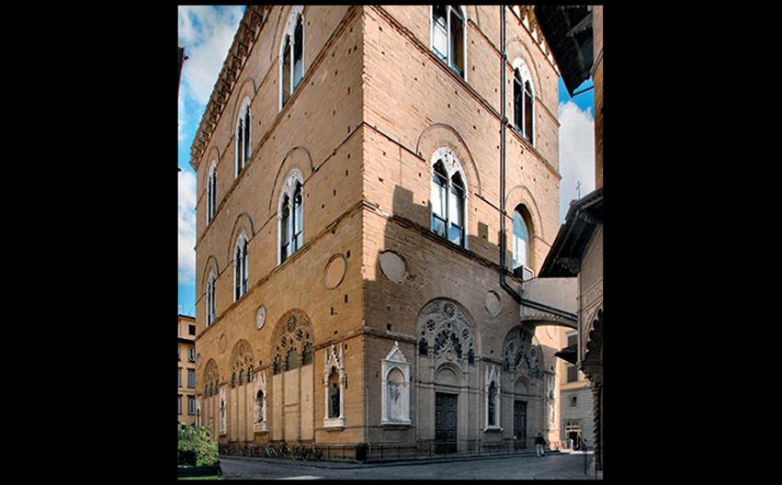
EXTERIOR VIEW OF ORSANMICHELE SHOWING SCULPTURE IN NICHES Florence. Begun 1337. © Studio Fotografico Quattrone, Florence.
Notes:
EXTERIOR VIEW OF ORSANMICHELE SHOWING SCULPTURE IN NICHES Florence. Begun 1337. © Studio Fotografico Quattrone, Florence.

Slide 29
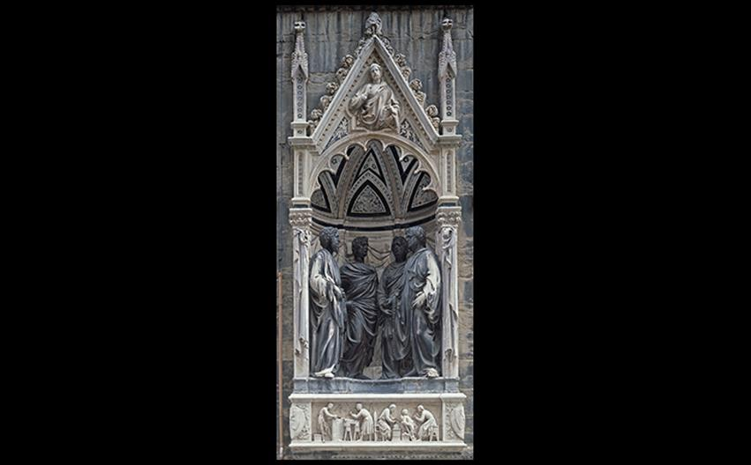
Nanni di Banco THE FOUR CROWNED MARTYRS c. 1409–1417. Marble, height of figures 6' (1.83 m). Photographed in situ before removal of the figures to the Museo di Orsanmichele, Florence. © Studio Fotografico Quattrone, Florence.
Notes:
Nanni di Banco THE FOUR CROWNED MARTYRS c. 1409–1417. Marble, height of figures 6' (1.83 m). Photographed in situ before removal of the figures to the Museo di Orsanmichele, Florence. © Studio Fotografico Quattrone, Florence.

Slide 30
Sculpture (3 of 6)
Orsanmichele
Donatello received three commissions for the niches at Orsanmichele.
As originally conceived St. George would have been a standing advertisement for the guild of armorers and swordmakers.
The figure of St. George stands in contrapposto with a complex expression on his determined face.

Slide 31
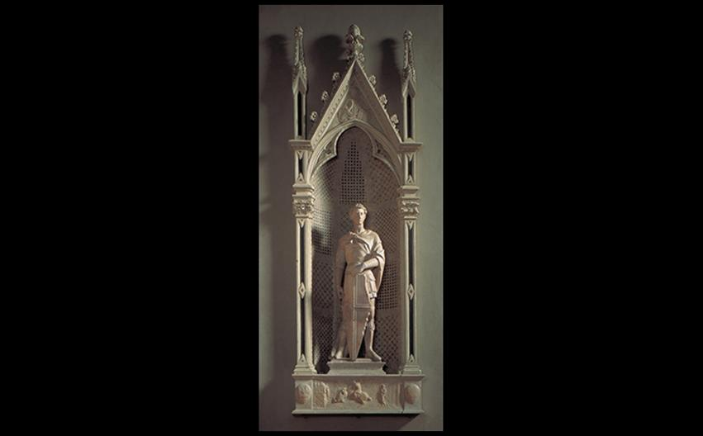
Donatello ST. GEORGE Formerly in Orsanmichele, Florence. 1417–1420. Marble, height 6'5" (1.95 m). Museo Nazionale del Bargello, Florence. © Studio Fotografico Quattrone, Florence.
Notes:
Donatello ST. GEORGE Formerly in Orsanmichele, Florence. 1417–1420. Marble, height 6'5" (1.95 m). Museo Nazionale del Bargello, Florence. © Studio Fotografico Quattrone, Florence.

Slide 32
Sculpture (4 of 6)
Donatello
Donatello made the statue of David to draw on the Classical tradition of heroic nudity.
It is unknown when this statue was made, but it was first recorded in 1469.
Some historians cite the angular pose as an attempt to heighten the character's heroism, while others see overt homoeroticism.

Slide 33
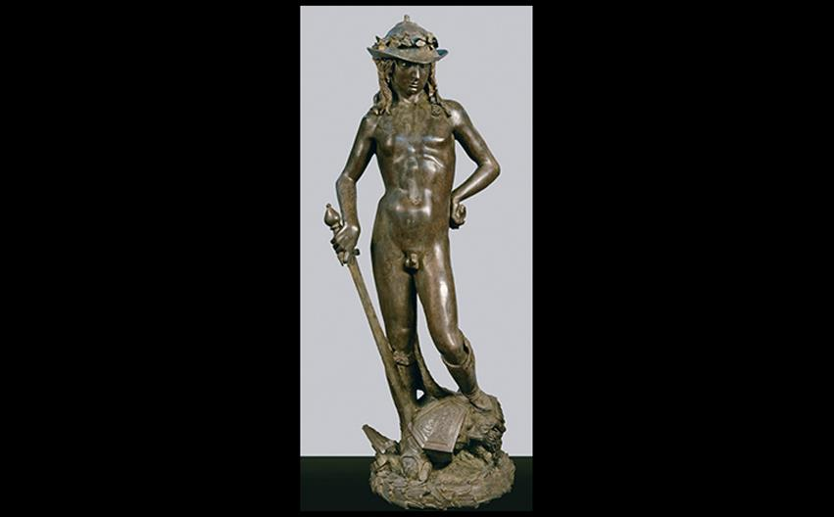
Donatello DAVID c. 1446–1460(?). Bronze, height 5'2-1/4" (1.58 m). Museo Nazionale del Bargello, Florence. © Studio Fotografico Quattrone, Florence.
Notes:
Donatello DAVID c. 1446–1460(?). Bronze, height 5'2-1/4" (1.58 m). Museo Nazionale del Bargello, Florence. © Studio Fotografico Quattrone, Florence.

Slide 34
Sculpture (5 of 6)
Donatello
Called to Padua, Donatello created an equestrian statue of Erasmo da Narni nicknamed Gattamelata.
It was the first life-size bronze equestrian statue since antiquity.

Slide 35
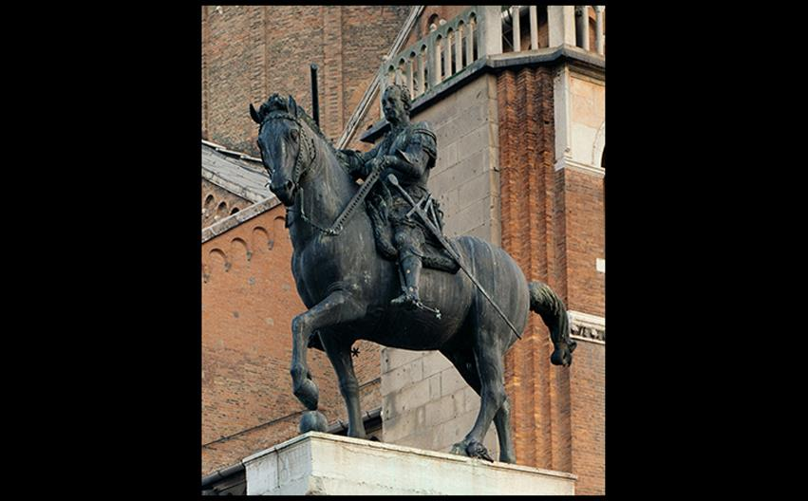
Donatello EQUESTRIAN STATUE OF ERASMO DA NARNI (GATTAMELATA) Piazza del Santo, Padua. 1443–1453. Bronze, height approx. 12'2" (3.71 m). © akg-images/Cameraphoto
Notes:
Donatello EQUESTRIAN STATUE OF ERASMO DA NARNI (GATTAMELATA) Piazza del Santo, Padua. 1443–1453. Bronze, height approx. 12'2" (3.71 m). © akg-images/Cameraphoto.

Slide 36
Sculpture (6 of 6)
Ghiberti's Gates of Paradise
Rival to Brunelleschi, Lorenzo Ghiberti labored on the bronze doors for Florence's baptistery, which were installed in 1452.
The story of Jacob and Esau demonstrates his attention to one-point perspective.
The vanishing point is under the loggia.

Slide 37
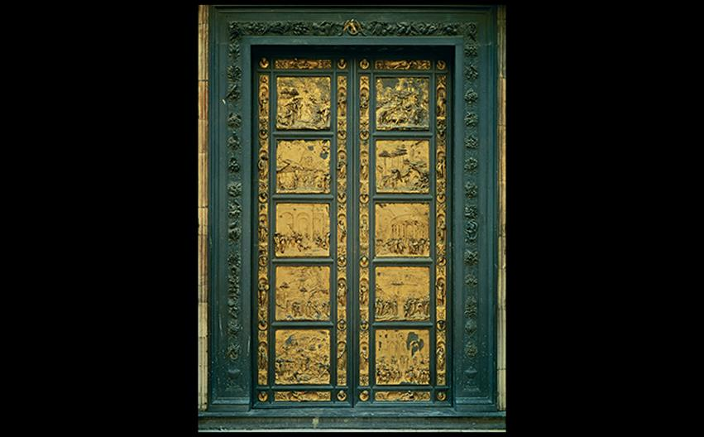
Lorenzo Ghiberti "GATES OF PARADISE" (EAST BAPTISTERY DOORS) Formerly on the Baptistery of San Giovanni, Florence. 1425–1452. Gilt bronze, height 15' (4.57 m). Museo dell'Opera del Duomo, Florence. © 2016 Photo Scala, Florence.
Notes:
Lorenzo Ghiberti "GATES OF PARADISE" (EAST BAPTISTERY DOORS) Formerly on the Baptistery of San Giovanni, Florence. 1425–1452. Gilt bronze, height 15' (4.57 m). Museo dell'Opera del Duomo, Florence. © 2016 Photo Scala, Florence

Slide 38
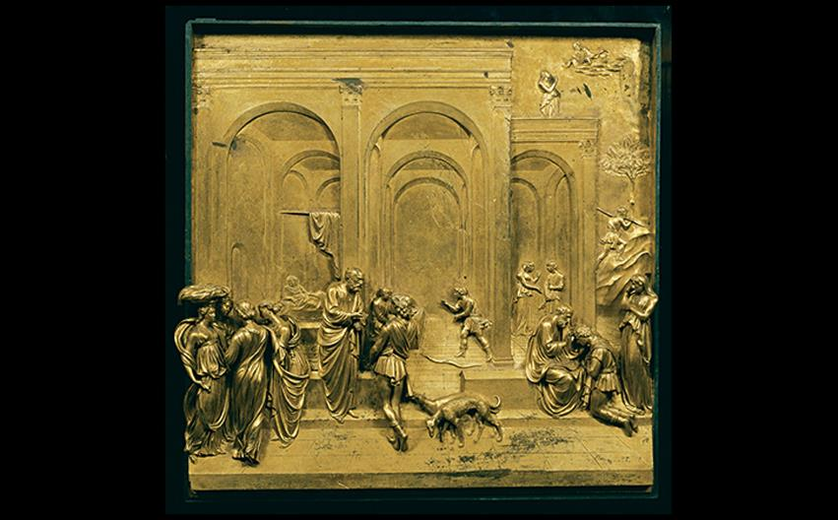
Lorenzo Ghiberti JACOB AND ESAU, PANEL OF THE "GATES OF PARADISE" (EAST BAPTISTERY DOORS) Formerly on the Baptistery of San Giovanni, Florence. c. 1435. Gilded bronze, 31-1/4" (79 cm) square. Museo dell'Opera del Duomo, Florence. © Studio Fotografico Quattrone, Florence.
Notes:
Lorenzo Ghiberti JACOB AND ESAU, PANEL OF THE "GATES OF PARADISE" (EAST BAPTISTERY DOORS) Formerly on the Baptistery of San Giovanni, Florence. c. 1435. Gilded bronze, 31-1/4" (79 cm) square. Museo dell'Opera del Duomo, Florence. © Studio Fotografico Quattrone, Florence.

Slide 39
Masaccio (1 of 2)
After a tradition of fresco painting, artists began to turn to oil paints.
Masaccio (1401–1428) painted the Trinity fresco to give the illusion that a stone funerary monument and alter receded into a deep aedicula niche.
The figures progress into space.
A skeleton evokes mortality in viewers.

Slide 40
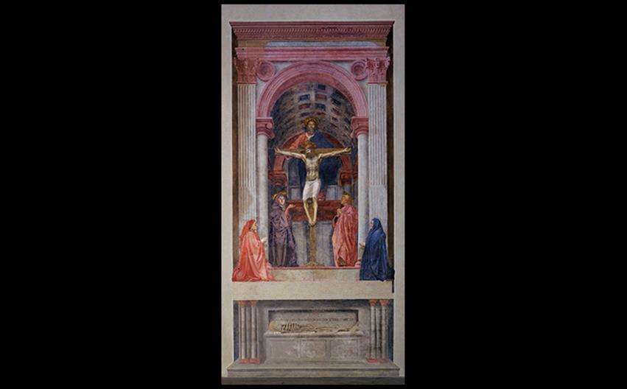
Masaccio TRINITY WITH THE VIRGIN, ST. JOHN THE EVANGELIST, AND DONORS Church of Santa Maria Novella, Florence. c. 1425–1427/1428. Fresco, 21' × 10'5" (6.4 × 3.2 m). © Studio Fotografico Quattrone, Florence.
Notes:
Masaccio TRINITY WITH THE VIRGIN, ST. JOHN THE EVANGELIST, AND DONORS Church of Santa Maria Novella, Florence. c. 1425–1427/1428. Fresco, 21' × 10'5" (6.4 × 3.2 m). © Studio Fotografico Quattrone, Florence.

Slide 41
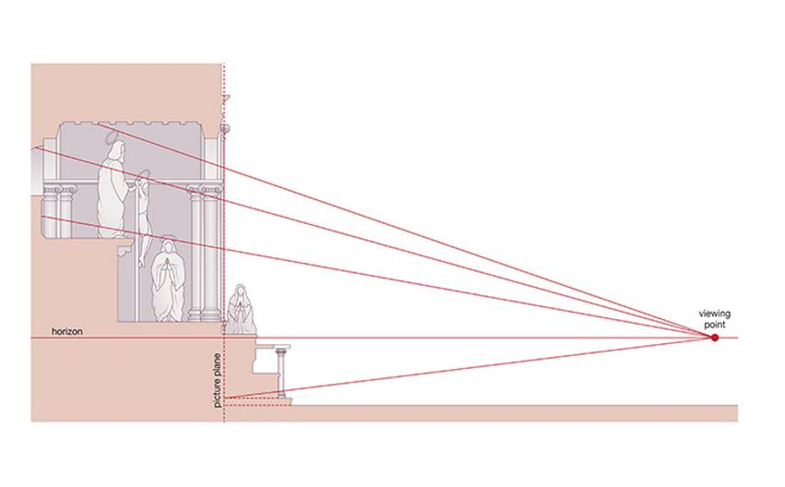
SECTION DIAGRAM OF THE ILLUSIONISTIC SPATIAL WORLD PORTRAYED IN MASACCIO'S TRINITY After Gene Brucker, Florence: The Golden Age, Berkeley, 1998.
Notes:
SECTION DIAGRAM OF THE ILLUSIONISTIC SPATIAL WORLD PORTRAYED IN MASACCIO'S TRINITY After Gene Brucker, Florence: The Golden Age, Berkeley, 1998.

Slide 42
Technique: Renaissance Perspective
Linear perspective was a rational method used to make realistic architectural settings.
Imaginary lines called orthogonals met at a single vanishing point on the horizon.
Variations in color and clarity can also convey the feeling of distance in a painting.

Slide 43
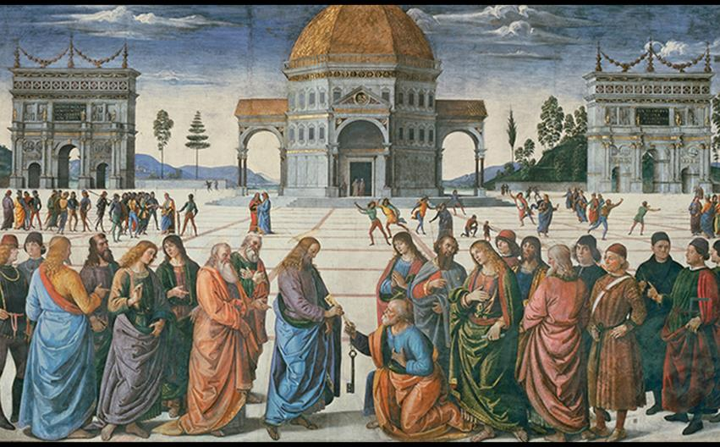
Perugino CHRIST GIVING THE KEYS TO ST. PETER Fresco on the right wall of the Sistine Chapel (see FIG. 20-41), Vatican, Rome. 1480–1482. 11'5-1/2" × 18'8-1/2" (3.48 × 5.70 m).
Notes:
Perugino CHRIST GIVING THE KEYS TO ST. PETER Fresco on the right wall of the Sistine Chapel (see FIG. 20-41), Vatican, Rome. 1480–1482. 11'5-1/2" × 18'8-1/2" (3.48 × 5.70 m).

Slide 44
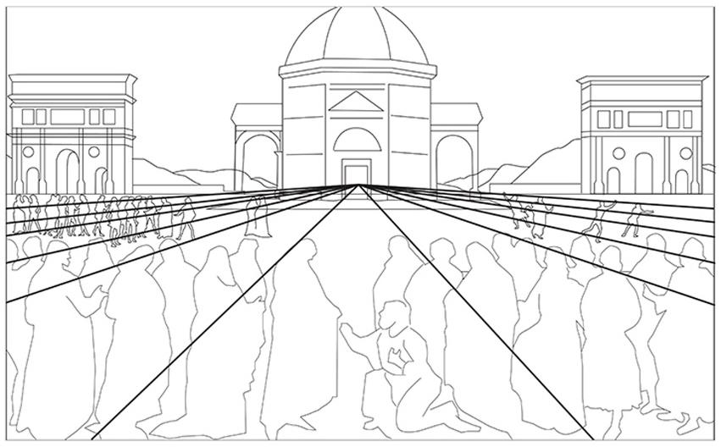
SCHEMATIC DRAWING SHOWING THE ORTHOGONALS AND VANISHING POINT OF CHRIST GIVING THE KEYS TO ST. PETER Canali Photobank, Milan, Italy
Notes:
SCHEMATIC DRAWING SHOWING THE ORTHOGONALS AND VANISHING POINT OF CHRIST GIVING THE KEYS TO ST. PETER Canali Photobank, Milan, Italy

Slide 45
Masaccio (2 of 2)
The Brancacci Chapel
The Expulsion of Adam and Eve from Paradise focuses on the mass of flesh of the figures' bodies and the psychological impact of shame.
The Tribute Money marks early use of linear and atmospheric perspective.
Foreground figures have bold highlights and long shadows on the ground.

Slide 46
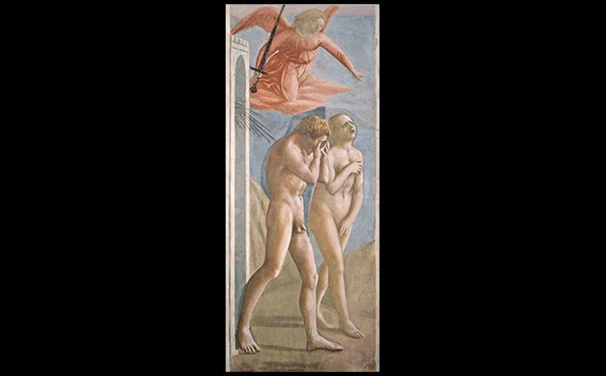
Masaccio THE EXPULSION OF ADAM AND EVE FROM PARADISE Brancacci Chapel, church of Santa Maria del Carmine, Florence. c. 1427. Fresco, 7' × 2'11" (214 × 90 cm). © Studio Fotografico Quattrone, Florence.
Notes:
Masaccio THE EXPULSION OF ADAM AND EVE FROM PARADISE Brancacci Chapel, church of Santa Maria del Carmine, Florence. c. 1427. Fresco, 7' × 2'11" (214 × 90 cm). © Studio Fotografico Quattrone, Florence.

Slide 47
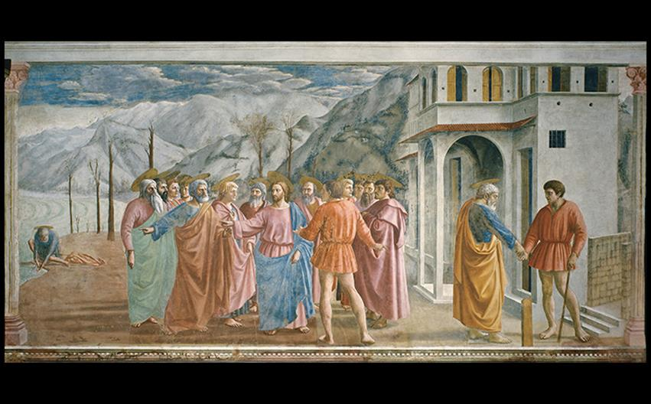
Masaccio THE TRIBUTE MONEY Brancacci Chapel, church of Santa Maria del Carmine, Florence. c. 1427. Fresco, 8'1" × 19'7" (2.46 × 6 m). © Studio Fotografico Quattrone, Florence.
Notes:
Masaccio THE TRIBUTE MONEY Brancacci Chapel, church of Santa Maria del Carmine, Florence. c. 1427. Fresco, 8'1" × 19'7" (2.46 × 6 m). © Studio Fotografico Quattrone, Florence.

Slide 48
Painting in Florence After Masaccio (1 of 4)
Fra Angelico
The pious Fra Angelico worked in Florence as early as 1417.
His Annunciation uses linear perspective to extend the corridor of the monastery where it was painted into an imagined portico and garden.
Slender, graceful figures render the scene with contemporary details.

Slide 49
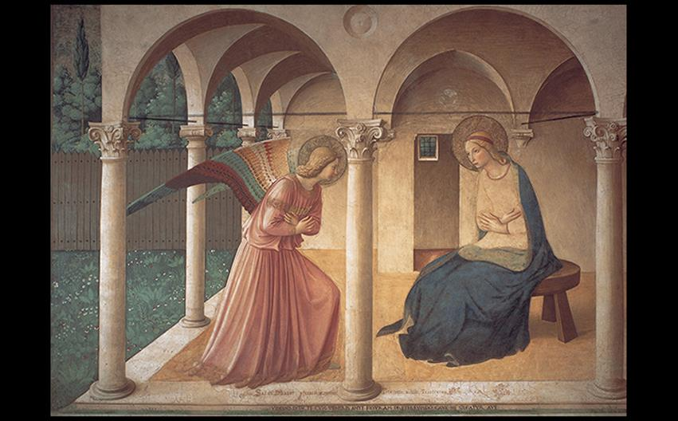
Fra Angelico ANNUNCIATION North dormitory corridor, monastery of San Marco, Florence. c. 1438–1445. Fresco, 7'1" × 10'6" (2.2 × 3.2 m). © Studio Fotografico Quattrone, Florence.
Notes:
Fra Angelico ANNUNCIATION North dormitory corridor, monastery of San Marco, Florence. c. 1438–1445. Fresco, 7'1" × 10'6" (2.2 × 3.2 m). © Studio Fotografico Quattrone, Florence

Slide 50
Painting in Florence After Masaccio (2 of 4)
Uccello
Paolo Uccello emerged as an eccentric painter specializing in the study of linear perspective.
An example is seen in The Battle of San Romano.

Slide 51
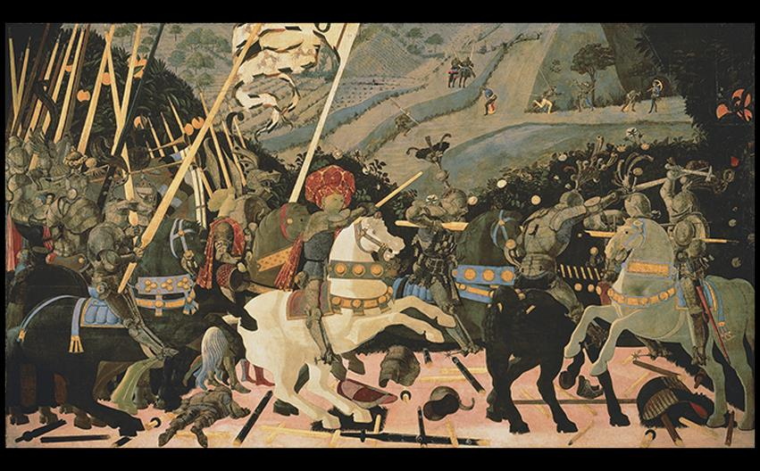
Paolo Uccello THE BATTLE OF SAN ROMANO 1438–1440. Tempera on wood panel, approx. 6' × 10'6" (1.82 × 3.2 m). National Gallery, London. © 2016. Copyright The National Gallery, London/Scala, Florence
Notes:
Paolo Uccello THE BATTLE OF SAN ROMANO 1438–1440. Tempera on wood panel, approx. 6' × 10'6" (1.82 × 3.2 m). National Gallery, London. © 2016. Copyright The National Gallery, London/Scala, Florence

Slide 52
Painting in Florence After Masaccio (3 of 4)
Castagno
Andrea del Castagno is best known for The Last Supper, a fresco showing Jesus and his followers at a humble-looking house.
Judas takes a traditional position on the viewer's side of the table.

Slide 53
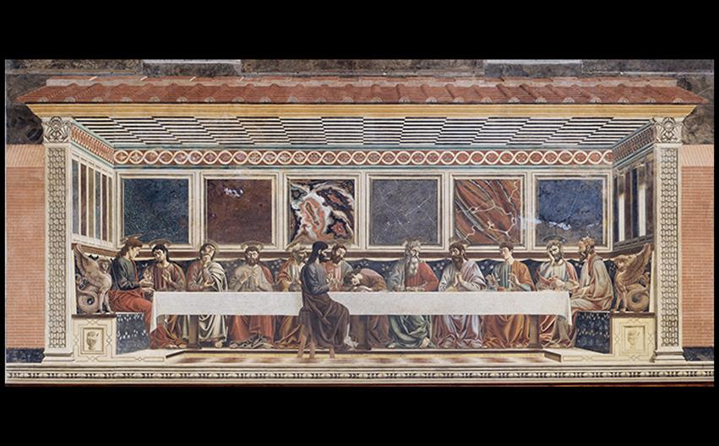
Andrea del Castagno THE LAST SUPPER Refectory, convent of Sant'Apollonia, Florence. 1447. Fresco, width approx. 16 × 32' (4.6 × 9.8 m). © Studio Fotografico Quattrone, Florence.
Notes:
Andrea del Castagno THE LAST SUPPER Refectory, convent of Sant'Apollonia, Florence. 1447. Fresco, width approx. 16 × 32' (4.6 × 9.8 m). © Studio Fotografico Quattrone, Florence.

Slide 54
Painting in Florence After Masaccio (4 of 4)
Fra Filippo Lippi
Portrait of a Woman and Man is an early work by Lippi.
Emphasis is squarely on the woman, spotlighted in the foreground.
There is no sense of engagement with the viewer and little sense of likeness of the figures to their sitters.
It is a puzzle to art historians as to what this painting symbolizes.

Slide 55
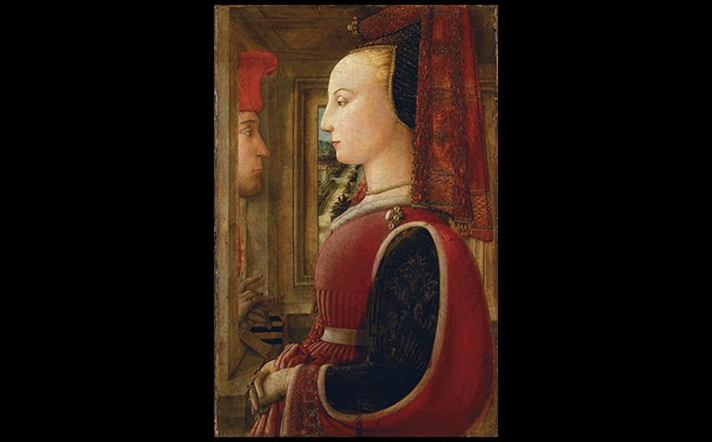
Fra Filippo Lippi PORTRAIT OF A WOMAN AND MAN (ANGIOLA DI BERNARDO SAPITI AND LORENZO DI RANIERI SCOLARI?) c. 1435–1445. Tempera on wood panel, 25-1/4" × 16-1/2" (64.1 × 41.9 cm). Metropolitan Museum of Art, New York. © 2016. Image copyright The Metropolitan Museum of Art/Art Resource/Scala, Florence.
Notes:
Fra Filippo Lippi PORTRAIT OF A WOMAN AND MAN (ANGIOLA DI BERNARDO SAPITI AND LORENZO DI RANIERI SCOLARI?) c. 1435–1445. Tempera on wood panel, 25-1/4" × 16-1/2" (64.1 × 41.9 cm). Metropolitan Museum of Art, New York. © 2016. Image copyright The Metropolitan Museum of Art/Art Resource/Scala, Florence.

Slide 56
Florentine Art in the Second Half of the Fifteenth Century
Sculptors in Florence continued to explore Classical themes.

Slide 57
Verrocchio
Trained as a goldsmith, Verrocchio was best known for works in paint and bronze.
David seems to have been conceived in response to Donatello's sculpture.

Slide 58
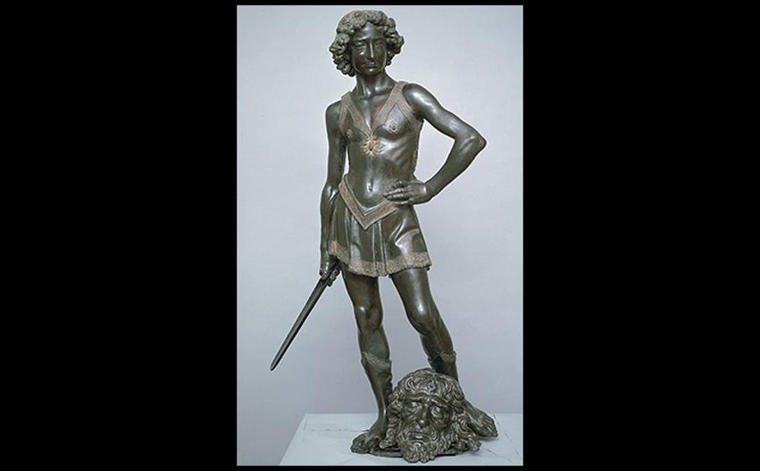
Andrea del Verrocchio DAVID Commissioned by Lorenzo de' Medici for the Medici Palace. c. 1470–1475. Bronze with gilded details, height 49-5/8" (1.26 m). Museo Nazionale del Bargello, Florence. © Studio Fotografico Quattrone, Florence
Notes:
Andrea del Verrocchio DAVID Commissioned by Lorenzo de' Medici for the Medici Palace. c. 1470–1475. Bronze with gilded details, height 49-5/8" (1.26 m). Museo Nazionale del Bargello, Florence. © Studio Fotografico Quattrone, Florence

Slide 59
Pollaiuolo
Hercules and Antaeus is a sculpted study of complex, interlocking figures and can be appreciated best from every angle.
The engraved Battle of the Nudes reflects both the study of Classical sculpture and anatomical research.

Slide 60
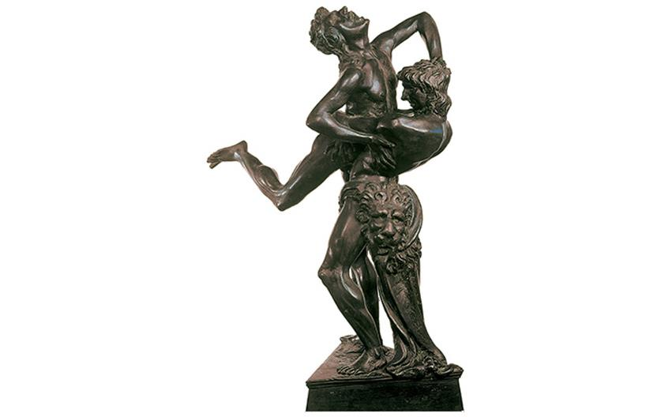
Antonio del Pollaiuolo HERCULES AND ANTAEUS c. 1475. Bronze, height with base 18" (45.7 cm). Museo Nazionale del Bargello, Florence. © 2016. Photo Scala, Florence - courtesy of the Ministero Beni e Att. Culturali.
Notes:
Antonio del Pollaiuolo HERCULES AND ANTAEUS c. 1475. Bronze, height with base 18" (45.7 cm). Museo Nazionale del Bargello, Florence. © 2016. Photo Scala, Florence - courtesy of the Ministero Beni e Att. Culturali.

Slide 61
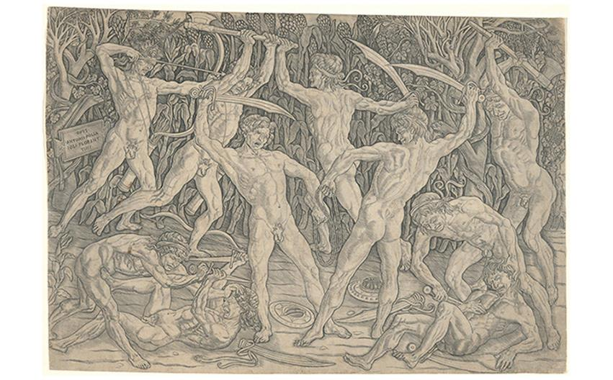
Antonio del Pollaiuolo THE BATTLE OF THE NUDES c. 1490. Engraving, 15-3/4" × 22-13/16" (40 × 58 cm). Yale University Art Gallery, New Haven, Connecticut. Maitland F. Griggs, B.A. 1896, Fund (1951.9.18). Image courtesy Yale University Art Gallery.
Notes:
Antonio del Pollaiuolo THE BATTLE OF THE NUDES c. 1490. Engraving, 15-3/4" × 22-13/16" (40 × 58 cm). Yale University Art Gallery, New Haven, Connecticut. Maitland F. Griggs, B.A. 1896, Fund (1951.9.18). Image courtesy Yale University Art Gallery.

Slide 62
The Morelli-Nerli Wedding Chests
Cassoni were chests used to store clothing and other objects in a couple's bedroom, associated with wedding gifts.
Marriages in Florence were political alliances rather than based in romance.
This example shows paintings with subjects drawn from stories extolling moral virtues.

Slide 63
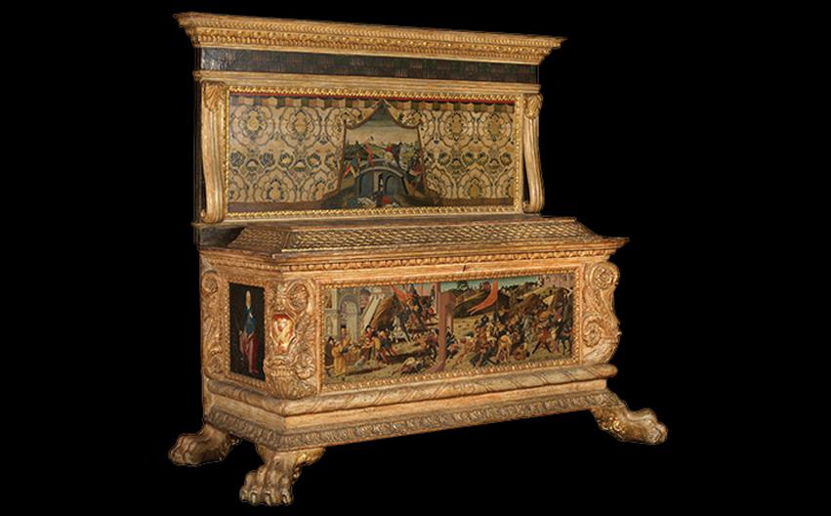
Jacopo del Sellaio, Biagio d'Antonio (painters), and Zanobi di Domenico (woodworker) CASSONE MADE FOR THE MARRIAGE OF LORENZO DI MATTEO MORELLI AND VAGGIA DI TANAI NERLI (ONE OF A SET OF TWO) 1472. Tempera and gold on wood, chest 83-1/2" × 75" × 30" (212 × 193 × 76.2 cm). The Samuel Courtauld Trust, The Courtauld Gallery, London. (F.1947.LF.4) © Samuel Courtauld Trust, The Courtauld Gallery, London, UK/Bridgeman Images
Notes:
Jacopo del Sellaio, Biagio d'Antonio (painters), and Zanobi di Domenico (woodworker) CASSONE MADE FOR THE MARRIAGE OF LORENZO DI MATTEO MORELLI AND VAGGIA DI TANAI NERLI (ONE OF A SET OF TWO) 1472. Tempera and gold on wood, chest 83-1/2" × 75" × 30" (212 × 193 × 76.2 cm). The Samuel Courtauld Trust, The Courtauld Gallery, London. (F.1947.LF.4) © Samuel Courtauld Trust, The Courtauld Gallery, London, UK/Bridgeman Images

Slide 64
Ghirlandaio (1 of 2)
The Life of St. Francis was commissioned for the walls of the Sassetti burial chapel.
Foreground figures are portraits of well-known Florentines.
The scene takes place in the actual piazza outside the church of Santa Trinità.

Slide 65
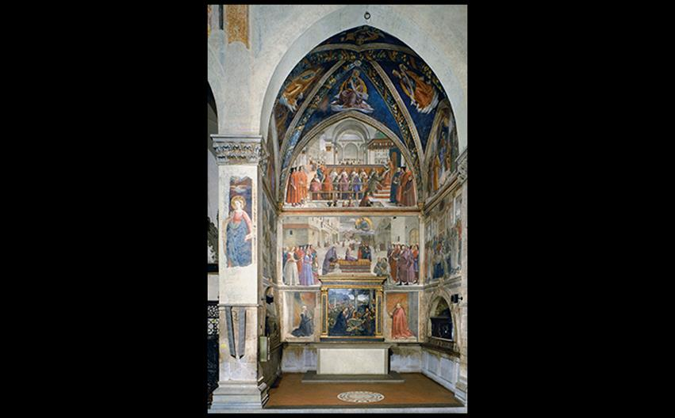
Domenico Ghirlandaio SCENES FROM THE LIFE OF ST. FRANCIS; ALTARPIECE WITH NATIVITY AND ADORATION OF THE SHEPHERDS Sassetti Chapel, church of Santa Trinità, Florence. 1483–1486. Fresco, chapel 12'2" deep × 17'2" wide (3.7 × 5.25 m). © Archivi Alinari, Firenze.
Notes:
Domenico Ghirlandaio SCENES FROM THE LIFE OF ST. FRANCIS; ALTARPIECE WITH NATIVITY AND ADORATION OF THE SHEPHERDS Sassetti Chapel, church of Santa Trinità, Florence. 1483–1486. Fresco, chapel 12'2" deep × 17'2" wide (3.7 × 5.25 m). © Archivi Alinari, Firenze.

Slide 66
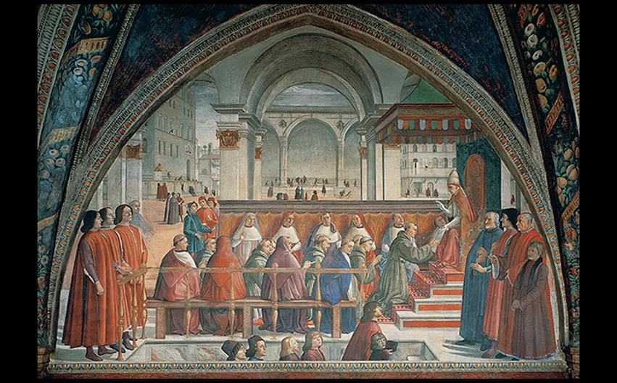
Domenico Ghirlandaio CONFIRMATION OF THE FRANCISCAN RULE BY POPE HONORIUS III Sassetti Chapel, church of Santa Trinità, Florence. 1483–1486. Fresco, width at base 17'2" (5.25 m). © Studio Fotografico Quattrone, Florence.
Notes:
Domenico Ghirlandaio CONFIRMATION OF THE FRANCISCAN RULE BY POPE HONORIUS III Sassetti Chapel, church of Santa Trinità, Florence. 1483–1486. Fresco, width at base 17'2" (5.25 m). © Studio Fotografico Quattrone, Florence.

Slide 67
Ghirlandaio (2 of 2)
Nativity and Adoration of the Shepherds was the altarpiece of the chapel, still in its original frame.
It was heavily influenced by the Portinari Altarpiece, but also draws upon Classical references to Rome.
Aerial perspective creates a seamless transition of color.

Slide 68
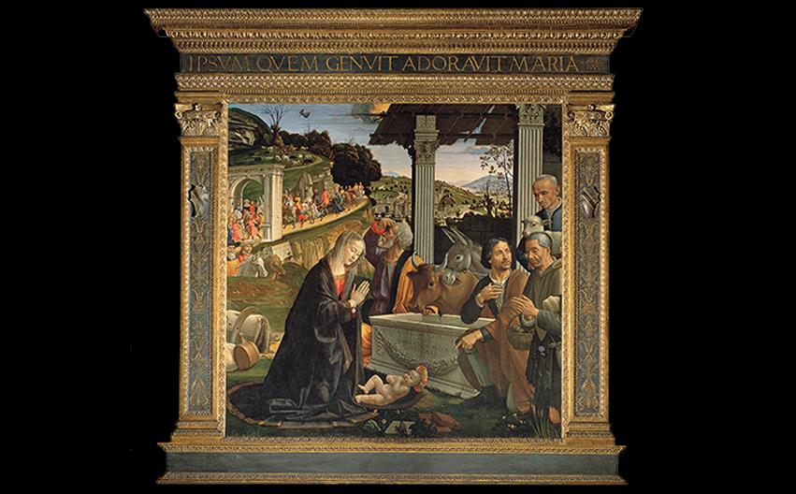
Domenico Ghirlandaio NATIVITY AND ADORATION OF THE SHEPHERDS Altarpiece in the Sassetti Chapel, church of Santa Trinità, Florence. 1485. Panel, 65-3/4" square (1.67 m square). © Studio Fotografico Quattrone, Florence
Notes:
Domenico Ghirlandaio NATIVITY AND ADORATION OF THE SHEPHERDS Altarpiece in the Sassetti Chapel, church of Santa Trinità, Florence. 1485. Panel, 65-3/4" square (1.67 m square). © Studio Fotografico Quattrone, Florence

Slide 69
Botticelli (1 of 2)
The overall appearance of Primavera recalls Flemish tapestries.
It is a complex allegory of Neoplatonic philosophers' conceptions of Venus as having two natures.
It was painted at the time of the wedding of Lorenzo de' Medici and Semiramide d'Appiano in 1482.

Slide 70
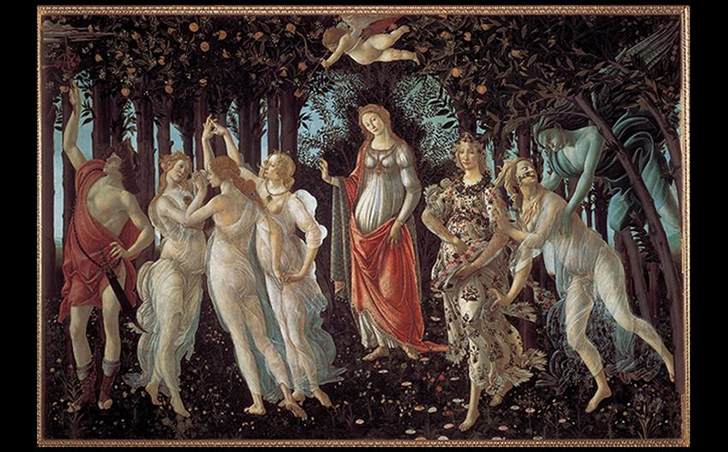
A CLOSER LOOK: Primavera by Sandro Botticelli c. 1482. Tempera on wood panel. 6'8" × 10'4" (2.03 × 3.15 m). Galleria degli Uffizi, Florence. © Studio Fotografico Quattrone, Florence.
Notes:
A CLOSER LOOK: Primavera by Sandro Botticelli c. 1482. Tempera on wood panel. 6'8" × 10'4" (2.03 × 3.15 m). Galleria degli Uffizi, Florence. © Studio Fotografico Quattrone, Florence.

Slide 71
Botticelli (2 of 2)
Sandro Botticelli's Birth of Venus depicted Classical figures with fluid grace.
The "modest Venus" image derives from a Classical Greek statue often copied by the Romans.

Slide 72
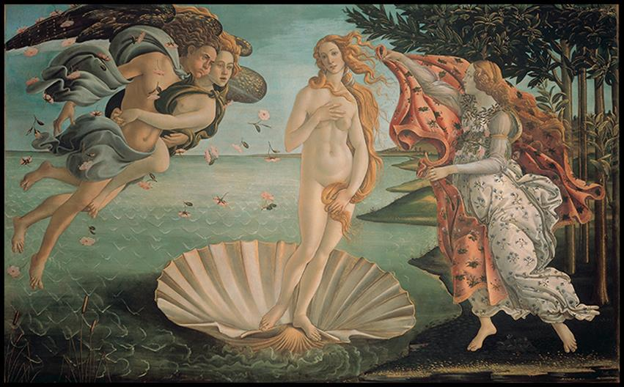
Sandro Botticelli BIRTH OF VENUS c. 1484–1486. Tempera and gold on canvas, 5'8-7/8" × 9'1-7/8" (1.8 × 2.8 m). Galleria degli Uffizi, Florence. © Studio Fotografico Quattrone, Florence.
Notes:
Sandro Botticelli BIRTH OF VENUS c. 1484–1486. Tempera and gold on canvas, 5'8-7/8" × 9'1-7/8" (1.8 × 2.8 m). Galleria degli Uffizi, Florence. © Studio Fotografico Quattrone, Florence.

Slide 73
Urbino, Mantua, Rome, and Venice
The ideas of Brunelleschi, Donatello, Masaccio, and other contemporaries spread from Florence to the rest of Italy.

Slide 74
Urbino (1 of 4)
The Palace at Urbino
Luciano Laurana's design of the courtyard avoided the awkwardness of two arches springing from a single column.
He used a variation of the composite capital on the ground level.

Slide 75
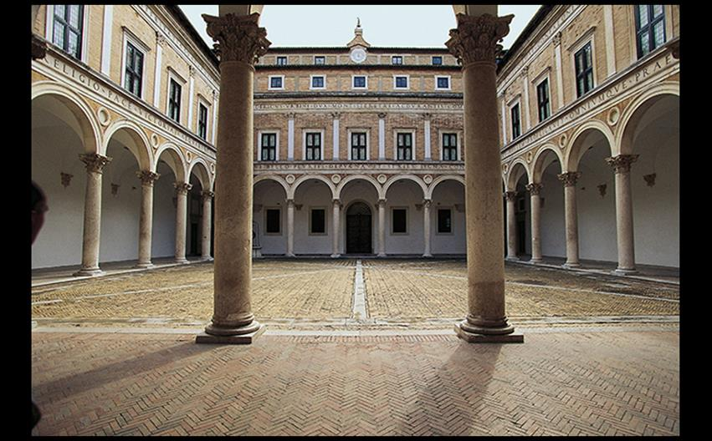
Luciano Laurana COURTYARD, DUCAL PALACE, URBINO Courtyard c. 1467–1472; palace begun c. 1450. © akg-images/De Agostini Picture Lib./L. Romano.
Notes:
Luciano Laurana COURTYARD, DUCAL PALACE, URBINO Courtyard c. 1467–1472; palace begun c. 1450. © akg-images/De Agostini Picture Lib./L. Romano.

Slide 76
Urbino (2 of 4)
The Palace at Urbino
The interior featured trompe l'oeil paintings, enhanced by linear perspective and foreshortening.
An example is the Studolio, or study, featuring the motif of a squirrel.

Slide 77
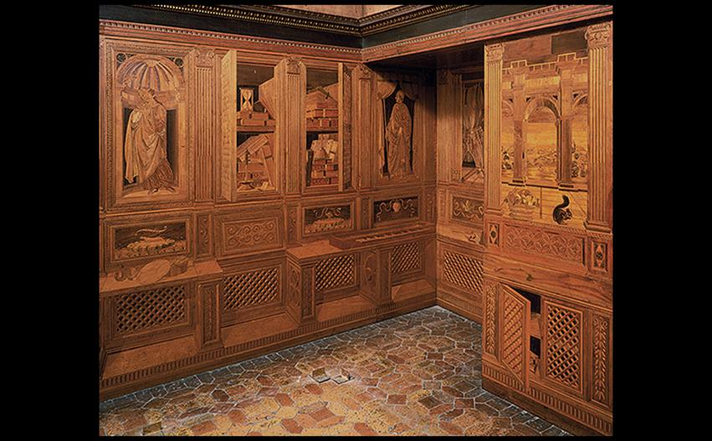
Giuliano da Maiano (?) STUDIOLO OF FEDERICO DA MONTEFELTRO Ducal palace, Urbino. 1476. Intarsia, height 7'3" (2.21 m). © 2016. Photo Scala, Florence – courtesy of the Ministero Beni e Att. Culturali.
Notes:
Giuliano da Maiano (?) STUDIOLO OF FEDERICO DA MONTEFELTRO Ducal palace, Urbino. 1476. Intarsia, height 7'3" (2.21 m). © 2016. Photo Scala, Florence – courtesy of the Ministero Beni e Att. Culturali.

Slide 78
Urbino (3 of 4)
Piero della Francesca
Piero was one of few practicing artists who also wrote his own theory books.
Baptism of Christ, his signature work, shows a central Christ next to a tree trunk.
A radically foreshortened dove, John's baptismal dish, and clouds add stability above the vertical forms.

Slide 79
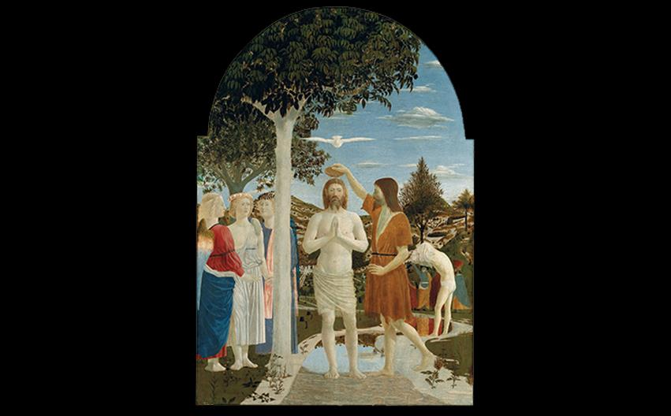
Piero della Francesca BAPTISM OF CHRIST c. 1450. Tempera on wood panel, 66" × 45-3/4" (1.67 × 1.16 m). National Gallery, London. © 2016. Copyright The National Gallery, London/Scala, Florence.
Notes:
Piero della Francesca BAPTISM OF CHRIST c. 1450. Tempera on wood panel, 66" × 45-3/4" (1.67 × 1.16 m). National Gallery, London. © 2016. Copyright The National Gallery, London/Scala, Florence.

Slide 80
Urbino (4 of 4)
Piero della Francesca
The portraits of Federico and Battista Sforza are in strict profile, disengaging them from the viewer but drawing attention away from Federico's scars.
The figures' meticulous clothes are silhouetted by atmospheric perspective.

Slide 81
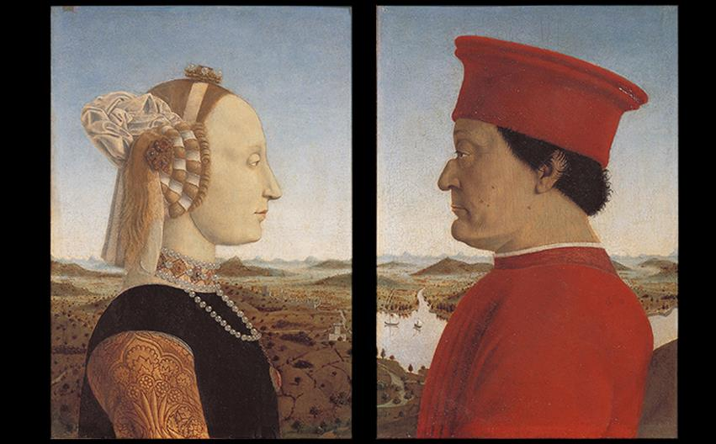
Piero della Francesca BATTISTA SFORZA AND FEDERICO DA MONTEFELTRO c. 1474. Oil on wood panel, each 18-1/2" × 13" (47 × 33 cm). Galleria degli Uffizi, Florence. © Studio Fotografico Quattrone, Florence.
Notes:
Piero della Francesca BATTISTA SFORZA AND FEDERICO DA MONTEFELTRO c. 1474. Oil on wood panel, each 18-1/2" × 13" (47 × 33 cm). Galleria degli Uffizi, Florence. © Studio Fotografico Quattrone, Florence.

Slide 82
Mantua
Andrea Mantenga (1431–1506) worked for the court of Ludovico Gonzaga.
Mantenga
The Camera Picta of the ducal palace displays unprecedented perspective and foreshortening.
Figures are seen di sotto in sù (directly from below), beginning a tradition of illusionistic ceiling painting.

Slide 83
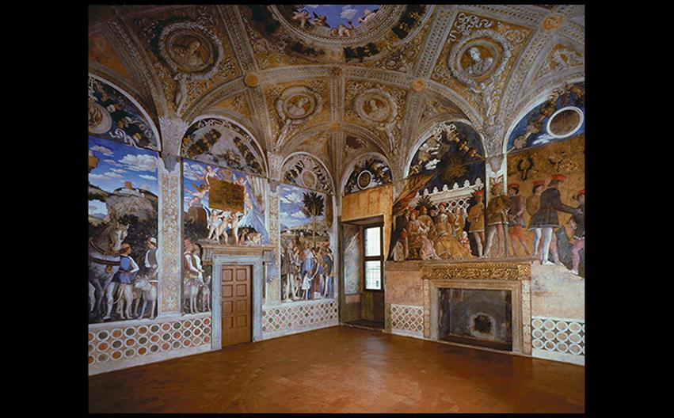
Andrea Mantegna TWO VIEWS OF THE CAMERA PICTA, DUCAL PALACE, MANTUA 1465–1474. Fresco, diameter of false oculus 8'9" (2.7 m); room 26'6" square (8 m square). © 2016. Photo Scala, Florence - courtesy of the Ministero Beni e Att. Culturali; © Studio Fotografico Quattrone, Florence
Notes:
Andrea Mantegna TWO VIEWS OF THE CAMERA PICTA, DUCAL PALACE, MANTUA 1465–1474. Fresco, diameter of false oculus 8'9" (2.7 m); room 26'6" square (8 m square). © 2016. Photo Scala, Florence - courtesy of the Ministero Beni e Att. Culturali; © Studio Fotografico Quattrone, Florence

Slide 84
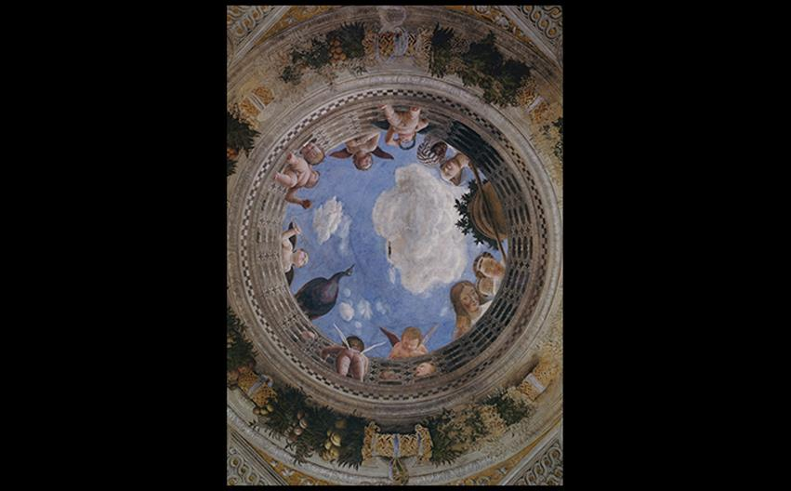
Andrea Mantegna TWO VIEWS OF THE CAMERA PICTA, DUCAL PALACE, MANTUA 1465–1474. Fresco, diameter of false oculus 8'9" (2.7 m); room 26'6" square (8 m square). © 2016. Photo Scala, Florence - courtesy of the Ministero Beni e Att. Culturali; © Studio Fotografico Quattrone, Florence
Notes:
Andrea Mantegna TWO VIEWS OF THE CAMERA PICTA, DUCAL PALACE, MANTUA 1465–1474. Fresco, diameter of false oculus 8'9" (2.7 m); room 26'6" square (8 m square). © 2016. Photo Scala, Florence - courtesy of the Ministero Beni e Att. Culturali; © Studio Fotografico Quattrone, Florence

Slide 85
Rome
Botticelli and Ghirlandaio were some of the first famous artists summoned to paint the Sistine Chapel, but art historians believe Perugino supervised the project.
Perugino
Christ Giving the Keys to St. Peter detailed figures with perfect scale, modeling, and perspective.

Slide 86
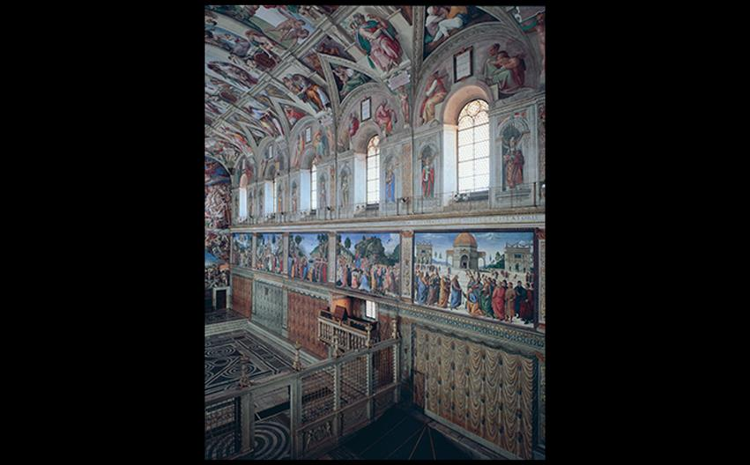
VIEW OF THE SISTINE CHAPEL SHOWING PAINTINGS COMMISSIONED FOR THE SIDE WALLS BY POPE SIXTUS IV Vatican, Rome. At lower right, Perugino's Christ Giving the Keys to St. Peter, c. 1480–1482. 11'5-1/2" × 18'8-1/2" (3.48 × 5.70 m). Photo © Musei Vaticani/IKONA
Notes:
VIEW OF THE SISTINE CHAPEL SHOWING PAINTINGS COMMISSIONED FOR THE SIDE WALLS BY POPE SIXTUS IV Vatican, Rome. At lower right, Perugino's Christ Giving the Keys to St. Peter, c. 1480–1482. 11'5-1/2" × 18'8-1/2" (3.48 × 5.70 m). Photo © Musei Vaticani/IKONA

Slide 87
Venice (1 of 5)
Venice emerged as a center for the arts as well as a commercial seaport.
The church of St. Mark was designed as a great Byzantine building, decorated with mosaics.
Textiles, jewelry, gold, enamel, glass, fine printing, and bookbinding were other specialties of Venetians.

Slide 88
Venice (2 of 5)
Venetian Palaces
The Ca d'Oro was home to nobleman Marino Contarini and features asymmetrical elevation and a Byzantine plan.
The façade was painted with white enamel and ultramarine blue.

Slide 89
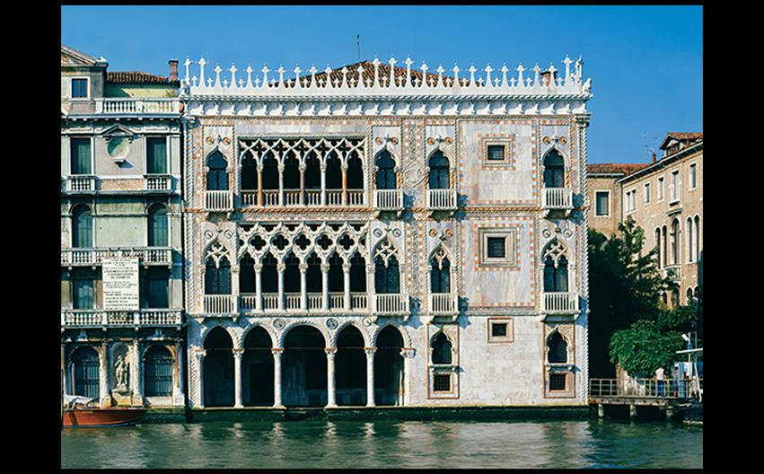
CA D'ORO (CONTARINI PALACE), VENICE 1421–1437. © Cameraphoto Arte, Venice.
Notes:
CA D'ORO (CONTARINI PALACE), VENICE 1421–1437. © Cameraphoto Arte, Venice

Slide 90
Venice (3 of 5)
The Bellini Brothers
Gentile Bellini created large, lively narratives such as the Procession of the Relic of the True Cross before the Church of St. Mark.
It serves as a reminder that fifteenth-century piazzas and buildings were sites of ritual ceremony.

Slide 91
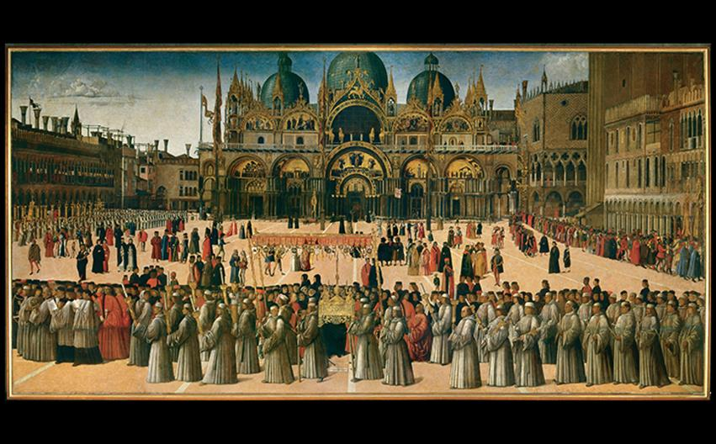
Gentile Bellini PROCESSION OF THE RELIC OF THE TRUE CROSS BEFORE THE CHURCH OF ST. MARK 1496. Oil on canvas, 12' × 24'5" (3.67 × 7.45 m). Galleria dell'Accademia, Venice. © Cameraphoto Arte, Venice.
Notes:
Gentile Bellini PROCESSION OF THE RELIC OF THE TRUE CROSS BEFORE THE CHURCH OF ST. MARK 1496. Oil on canvas, 12' × 24'5" (3.67 × 7.45 m). Galleria dell'Accademia, Venice. © Cameraphoto Arte, Venice.

Slide 92
Venice (4 of 5)
The Bellini Brothers
Giovanni Bellini's artistic virtuosity is seen in the Virgin and Child Enthroned with SS. Francis, John the Baptist, Job, Dominic, Sebastian, and Louis of Toulouse.
It exhibits radical foreshortening and a low vanishing point.

Slide 93
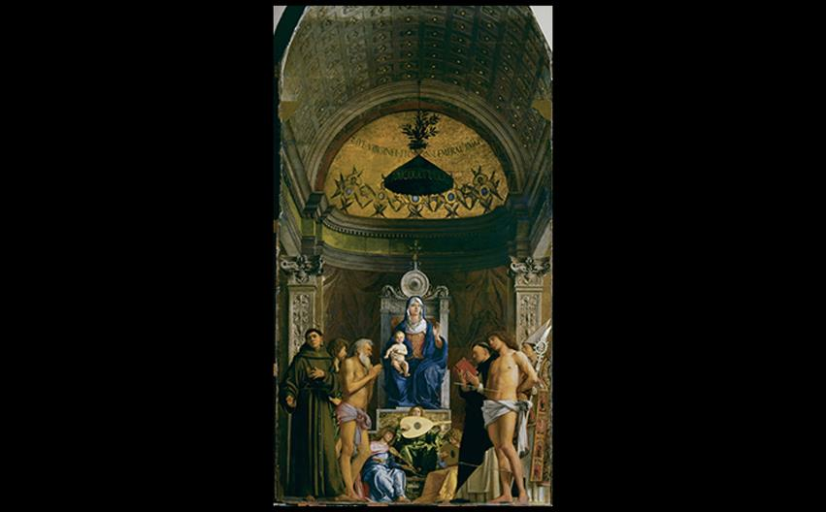
Giovanni Bellini VIRGIN AND CHILD ENTHRONED WITH SS. FRANCIS, JOHN THE BAPTIST, JOB, DOMINIC, SEBASTIAN, AND LOUIS OF TOULOUSE Originally commissioned for the chapel of the Hospital of San Giobbe, Venice. c. 1478. Oil on wood panel, 15'4" × 8'4" (4.67 × 2.54 m). Galleria dell’Accademia, Venice. © Cameraphoto Arte, Venice.
Notes:
Giovanni Bellini VIRGIN AND CHILD ENTHRONED WITH SS. FRANCIS, JOHN THE BAPTIST, JOB, DOMINIC, SEBASTIAN, AND LOUIS OF TOULOUSE Originally commissioned for the chapel of the Hospital of San Giobbe, Venice. c. 1478. Oil on wood panel, 15'4" × 8'4" (4.67 × 2.54 m). Galleria dell’Accademia, Venice. © Cameraphoto Arte, Venice.

Slide 94
Venice (5 of 5)
The Bellini Brothers
Giovanni's St. Francis in Ecstasy recalls Flemish art due to its fine detail.
The natural world depicted is saturated with religious symbolism.

Slide 95
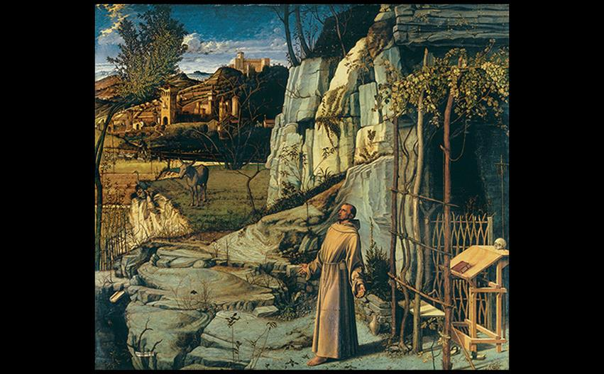
Giovanni Bellini ST. FRANCIS IN ECSTASY c. 1470s. Oil and tempera on wood panel, 49-1/16 × 55-7/8" (124.6 × 142 cm). The Frick Collection, New York.
Notes:
Giovanni Bellini ST. FRANCIS IN ECSTASY c. 1470s. Oil and tempera on wood panel, 49-1/16 × 55-7/8" (124.6 × 142 cm). The Frick Collection, New York.

